Slide 1
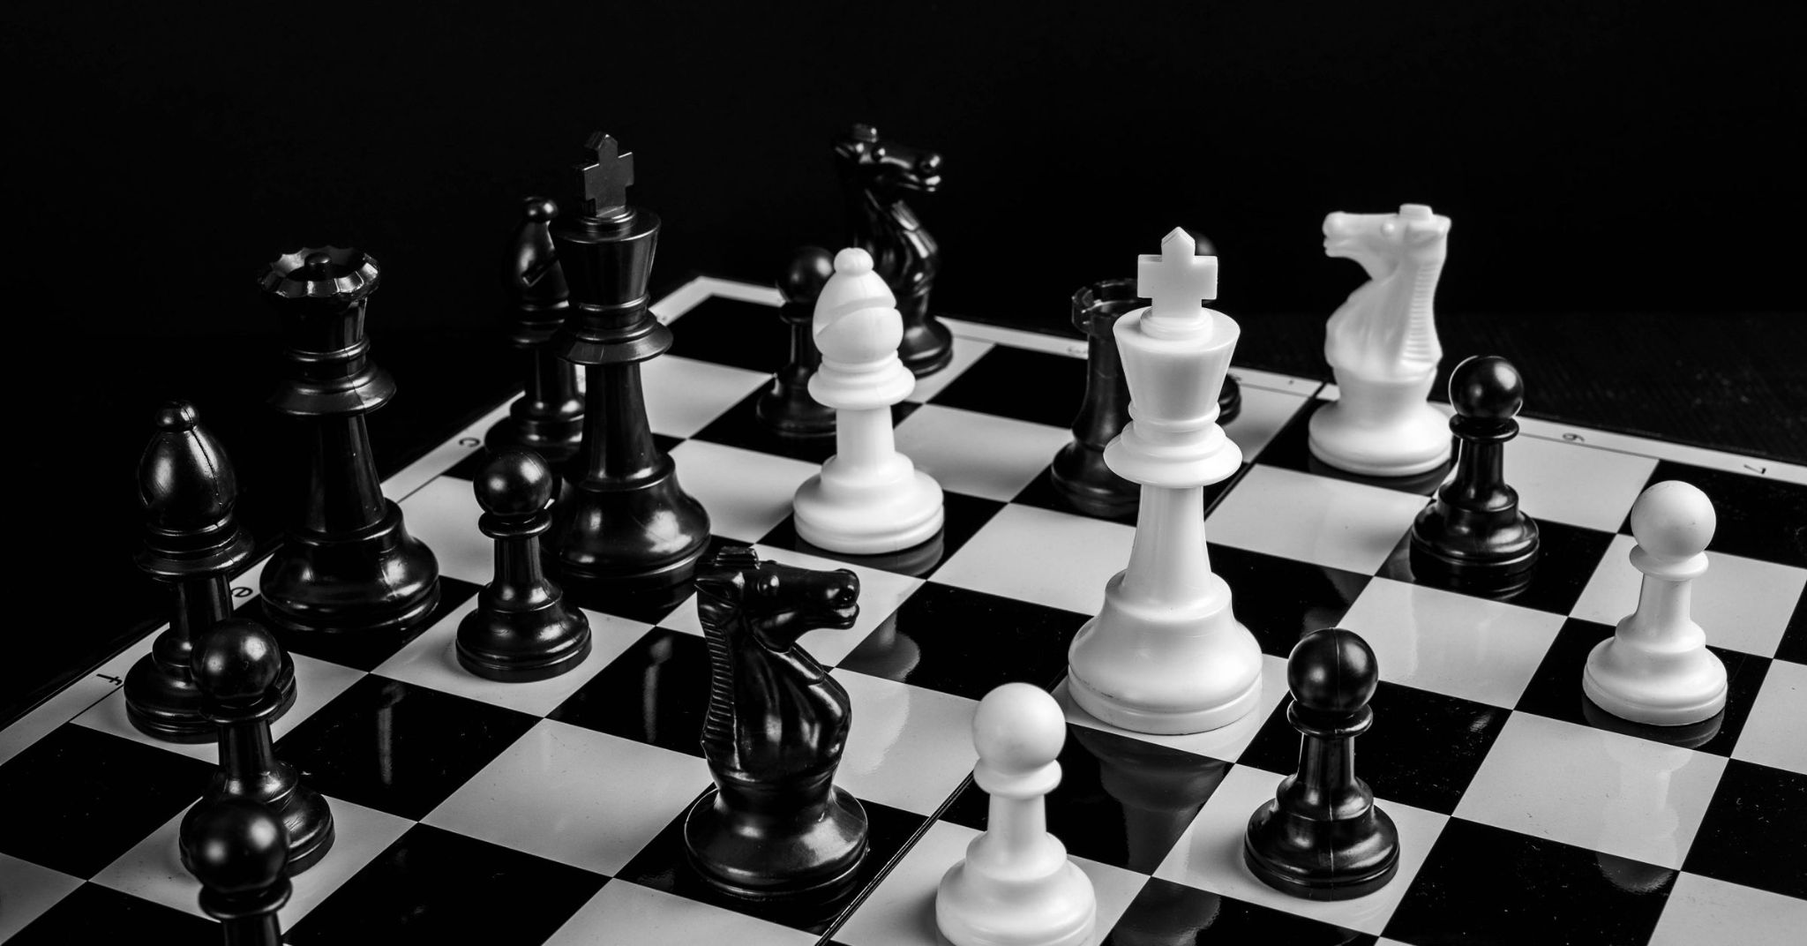
abstract strategy game
CHESS AI
AQSA YOUNUS - 18571

Slide 2
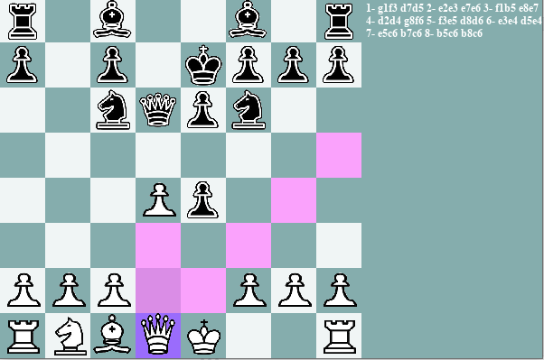
Features
2 AI game
2 player game
Highlights clicked pieces
Move Log at the right
Best first Search
MinMax Search
AlphaBeta Prunning
Animated Movements
Pygame/Random are the only imports used

Slide 3
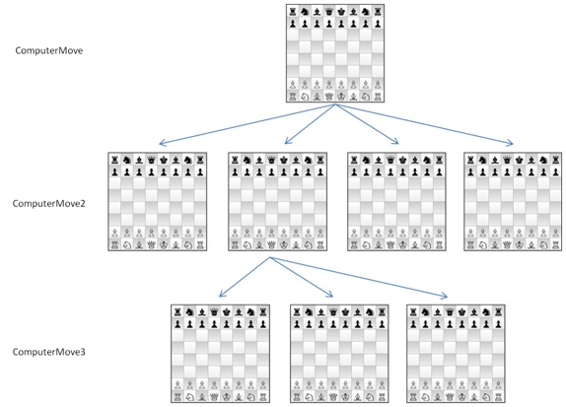
Chess and State Spaces
It as an 8x8 board with a complexity of exponential time
Each piece has a unique way of moving around on the Chess board
As the board keeps unfolding (pieces move around) it opens a finite (but large) amount of possible game states (space states)
Therefore the game can be seen as a tree and search algorithms can be implemented
Figure shows a small branch of a huge chess tree

Slide 4
Chess has a Dataset?
No, since each piece has a unique way of moving around on the board, the search algorithms, look for pieces that can cause the AI to “gain” points, and player to “lose” points. Therefore Chess is more of a “zero-sum game”
Chess is also known as an “abstract-strategy game” and by using more complex algorithms, Chess AI can be trained to play efficiently

Slide 5
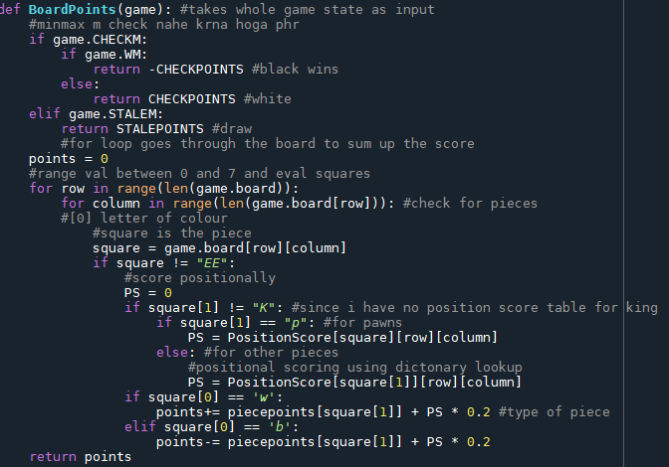
What Makes My AI Efficient?
Each Piece is assigned a score value according to the importance of piece
Each Piece has a 2D array that assigns positional value
Combining Positional score and Piece Score, the AI is able to make smarter moves when the search algorithms are implemented on it

Slide 6
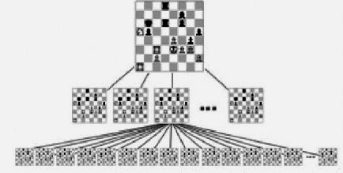
Greedy Best First Search
Works on the basis on Priority Queue, but modified slightly, the priority is taking the path that has the best score
Goes from top to bottom of tree
Due to top down greedy structure it does not have a hindsight
Not as efficient as MinMax or AlphaBeta but faster since it goes through a small section of state spaces
Makes best move based on maxisiming score based on pieces on board, therefore “greedy”
Greedy best-first search algorithm always selects the path which appears best at that moment. Not very smart, when it comes to abstract-strategy games
Time Complexity: (worst case) O(b^m).
Space Complexity: (Worst Case) O(b^m).
Where m is the maximum depth of the search space.

Slide 7
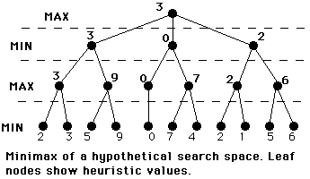
MinMax Search
Minimax is a kind of backtracking algorithm that is used in decision making and game theory to find the optimal move for a player, assuming that your opponent also plays optimally.
The maximizer tries to get the highest score possible while the minimizer tries to do the opposite and get the lowest score possible.
Every board state has a value associated with it. In a given state if the maximizer has upper hand then, the score of the board will tend to be some positive value. If the minimizer has the upper hand in that board state then it will tend to be some negative value
Definitely smarter than Greedy Best First Search, however increasing the depth causes the program to freeze, since Chess branches grow exponentially, Min-Max goes to every single state space making the AI super slow.
The time complexity of minimax is O(b^m) and the space complexity is O(bm), where b is the number of legal moves at each point and m is the maximum depth of the tree

Slide 8
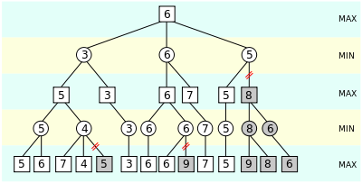
AlphaBeta Pruning
Alpha-beta pruning is a modified version of the minimax algorithm. It is an optimization technique for the minimax algorithm.
As we have seen in the minimax search algorithm that the number of game states it has to examine are exponential in depth of the tree. Since we cannot eliminate the exponent, but we can cut it to half.
Alpha-beta pruning can be applied at any depth of a tree, and sometimes it not only prune the tree leaves but also entire sub-tree.
Removes all the nodes which are not really affecting the final decision but making algorithm slow. Hence by pruning these nodes, it makes the algorithm fast.
This algorithm is relatively smarter than both of previous algorithms, however, after depth 4, the AI becomes as slow as the MinMax.
The time complexity of minimax is O(b^m) and the space complexity is O(bm), where b is the number of legal moves at each point and m is the maximum depth of the tree

Slide 9
Practical Use
Chess is a board game played worldwide by many people competitively and as a hobby. Chess is a game proven to develop perspective, sharpen memory and boosts planning skills.
Results
A fun game to play, the results are checkmate (a player wins) or stalemate (draw) depending whether the AI is smart or you :)

Slide 10
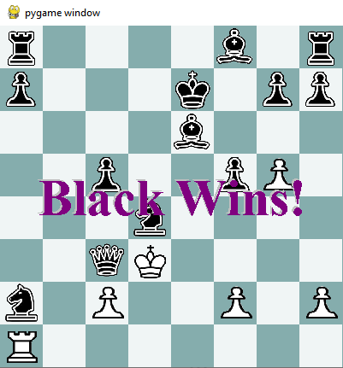
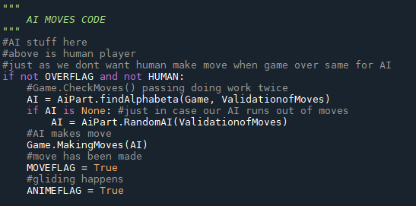
Text Display of End Game, same is for stalemate, section of AI code below.
Practical Use
Chess is a board game played worldwide by many people competitively and as a hobby. Chess is a game proven to develop perspective, sharpen memory and boosts planning skills.

Slide 11
abstract strategy game
Conclusion/Analysis
The AI is efficient in terms of informed searches, however there is always room for improvement which is beyond the scope of the project (bitboards). The game itself is super slow, this is because there is a heavy use of 2D arrays, which slows down the whole program. Of course in terms of smart-ness Alpha-Beta is smarter followed by MinMax and Greedy Best First, in terms of “quickness” Greedy Best First is followed by Alpha-Beta then MinMax. Min-Max looks at state spaces more than Alpha-Beta and Greedy Best First.

